Slide 1
Page Rank
Ljiljana Rajačić

Slide 2
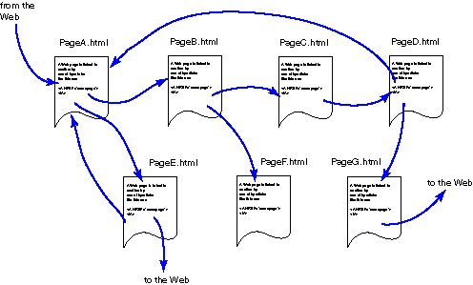
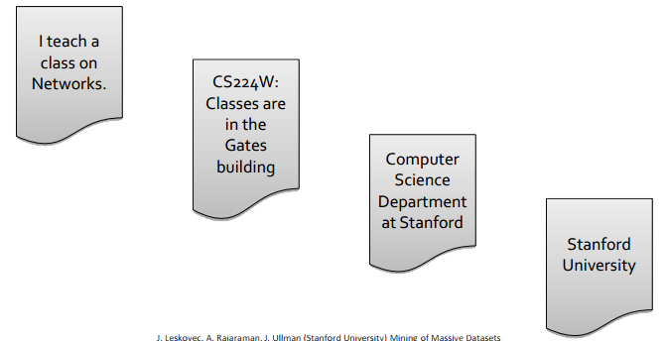
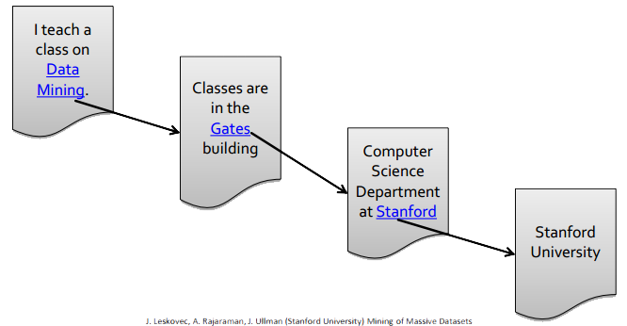
Web as a Graph
Web as a directed graph
  Nodes: Web pages
  Edges: Hyperlinks

Slide 3
Web Search: Challenges
Two challenges of web search
  Web contains many sources of information
    Who to trust?
  What is the “best” answer to a query?
    No single right answer
Not all web pages are equally “important”

Slide 4
Link analysis
Link analysis approaches
  Rank pages (nodes) by analyzing topology of the web graph
  Idea: Links as votes
    Page is more important if it has more links adjacent to it
  Incoming links? Outgoing links?
  Links from important pages have higher weight => recursive problem!

Slide 5
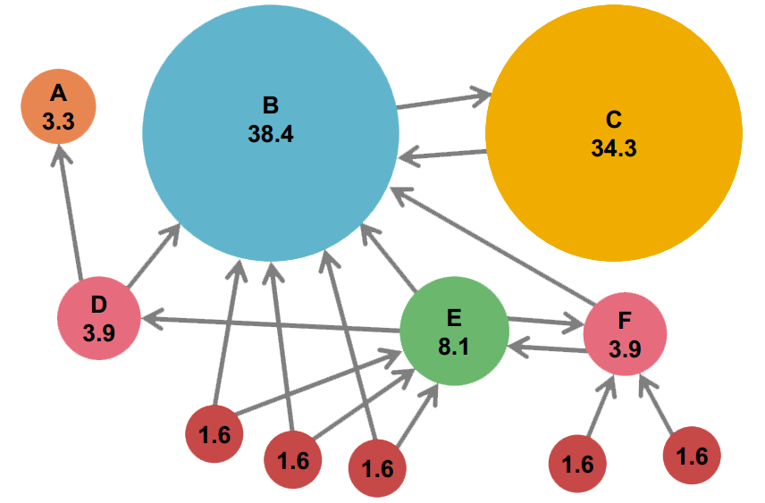
Example: Page Rank scores

Slide 6
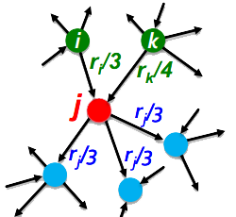

Recursive formulation
Link weight proportional to the importance of its source page
If page j with importance r_{j} has n out-links, each link gets r_{j} / n votes
Page j ‘s own importance is the sum of the votes on its in-links

Slide 7
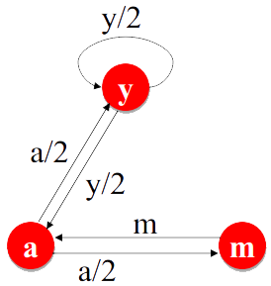
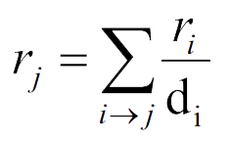
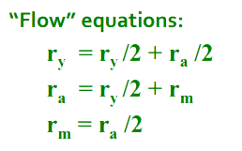
The Flow model
A page is important if it is pointed to by other important pages
Rank r_{j} of page j :
  d_{i} out-degree of node i

Slide 8
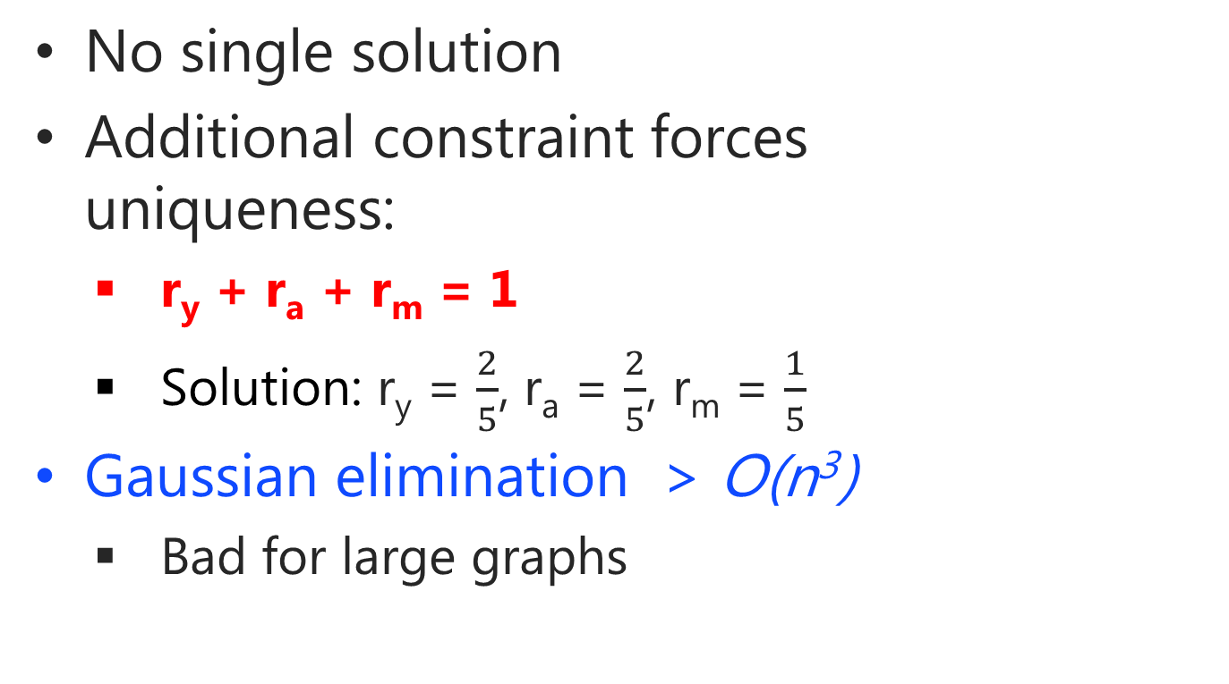
The Flow equations
No single solution
Additional constraint forces uniqueness:
  r_{y} + r_{a} + r_{m} = 1
  Solution: r_{y} = $\frac{2}{5}$, r_{a} = $\frac{2}{5}$, r_{m} = $\frac{1}{5}$
Gaussian elimination > O(n³)
  Bad for large graphs

Slide 9
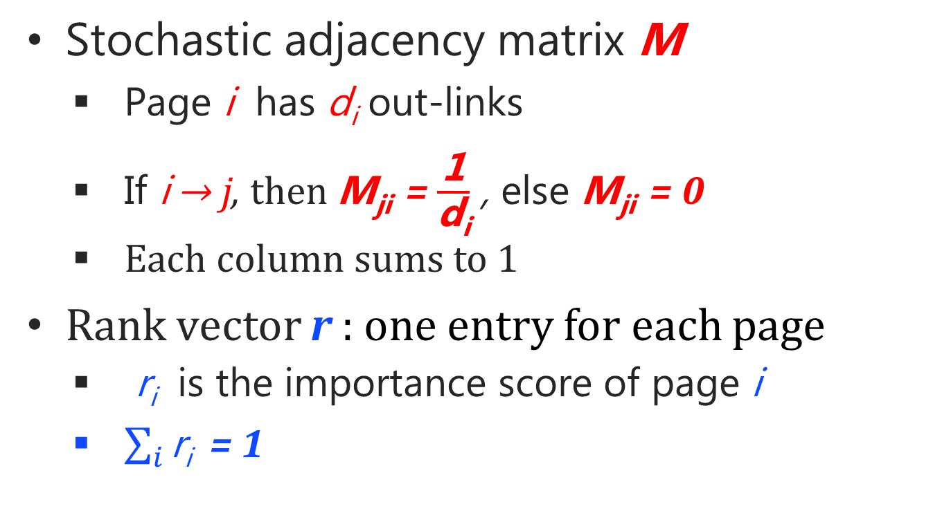
Matrix formulation
Stochastic adjacency matrix M
  Page i has d_{i} out-links
  If i → j, then M_{ji} = $\frac{\text{1}}{\text{d}\text{i}}$ , else M_{ji} = 0
  Each column sums to 1
Rank vector r : one entry for each page
  r_{i} is the importance score of page i
  $\sum_{i}{\text{r}\text{i} }$ = 1

Slide 10
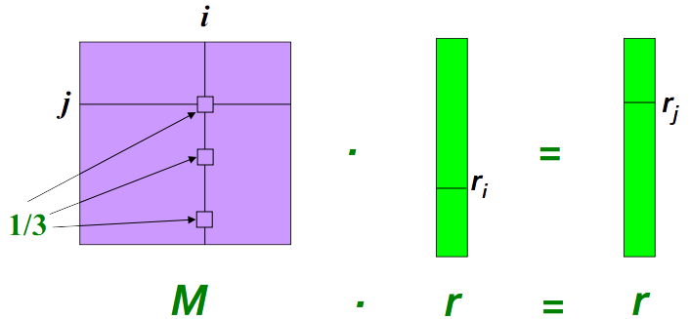
Matrix formulation
Since
Flow equasion in the matrix form:
M ∙ r = r
Page i links to 3 pages,
including j

Slide 11
Eigenvector formulation
x is an eigenvector with the corresponding eigenvalue λ if
Since
  Rank vector r is an eigenvector of web matrix M, with corresponding eigenvalue 1
We can now efficiently find r !
Power iteration method
Mx = λx
M ∙ r = r

Slide 12
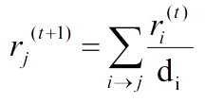
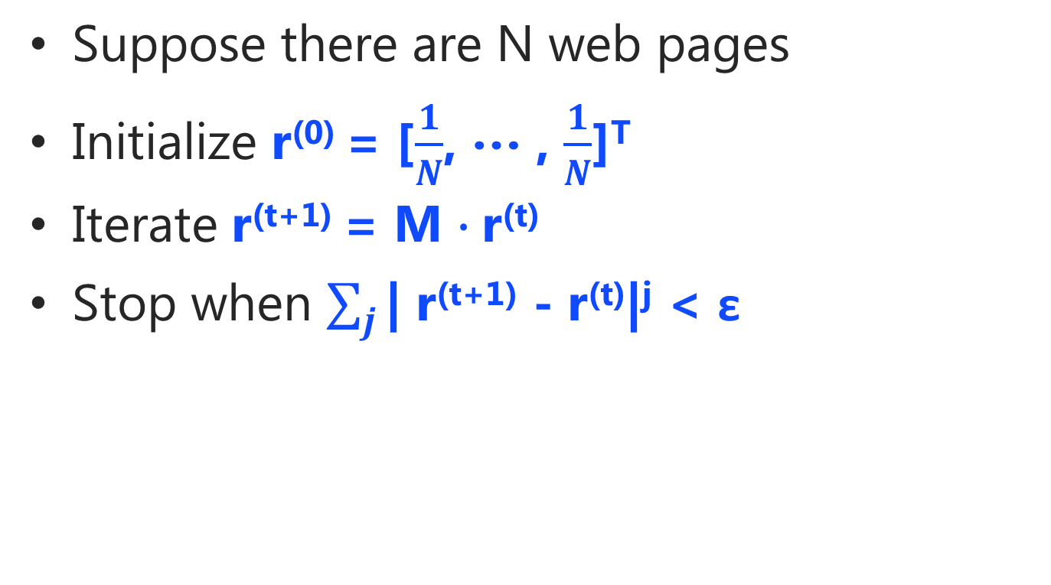
The power iteration
Suppose there are N web pages
Initialize r⁽⁰⁾ = [$\frac{1}{N}$, … , $\frac{1}{N}$]^{T}
Iterate r^{(t+1)} = M $∙$r^{(t)}
Stop when $\sum_{j}{\text{| }\text{r}\text{(}\text{t}\text{+1) − }\text{r}\text{(}\text{t}\text{)|}\text{j}}$ < ε
d_{i} – out-degree of node i

Slide 13
Random walk interpretation
Page rank simulates a random web surfer:
  At any time t, surfer is on some page i
  At t + 1, he follows an out-link from i uniformly at random
  Ends up on some page j linked from i
Rank vector r is a stationary distribution of probabilities that a random walker is on page i at arbitrary time t

Slide 14
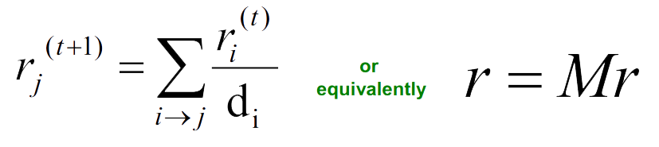
Page rank: three questions
Does this converge?
Does it converge to what we want?
Are the results reasonable?

Slide 15
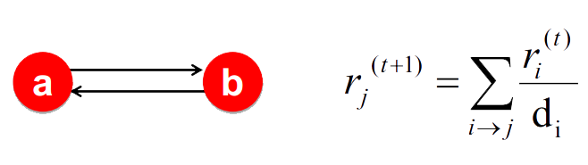
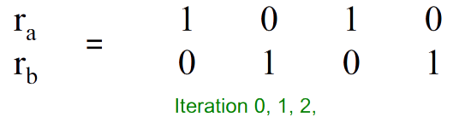
Spider trap problem
All out-links are within an isolated group
Spider traps absorbe all rank eventually

Slide 16
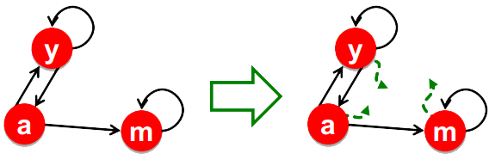
Spider traps: Google solution
At each step, random surfer has 2 options:
  Follow a random link with probability β
  Jump to random page with probability 1 – β
  β is usually in range 0.8 – 0.9

Slide 17
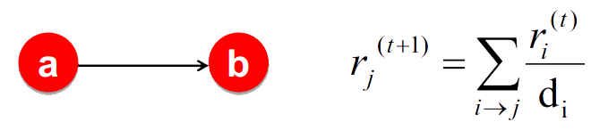
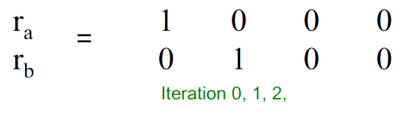
Dead ends problem
A dead end is a page with no out-links
They cause rank “leaking out”
All 0 in b’s column

Slide 18
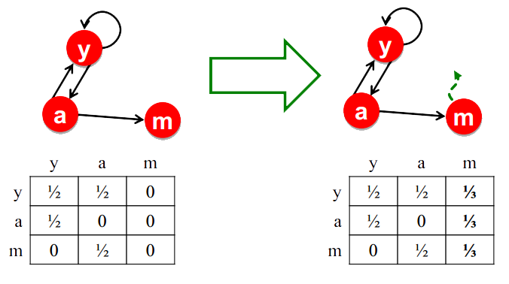
Dead ends: Google solution
Always jump to random page from a dead end

Slide 19
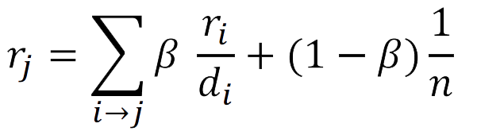
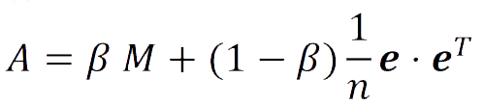
The Google matrix
PageRank equation [Brin – Page, 1998]:
Google matrix A:
e – vector of all 1s

Slide 20
Computing page rank
Key step is matrix – vector multiplication
A is dense – no 0 elements
M was sparse
  only ~ 10 – 100 non-zero elements per column
We want to work with M
It’s possible!

Slide 21
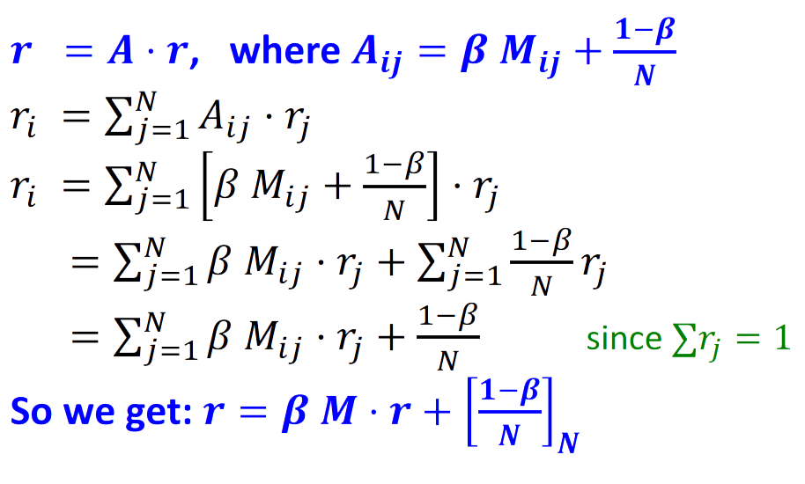
Rearranging the equation

Slide 22
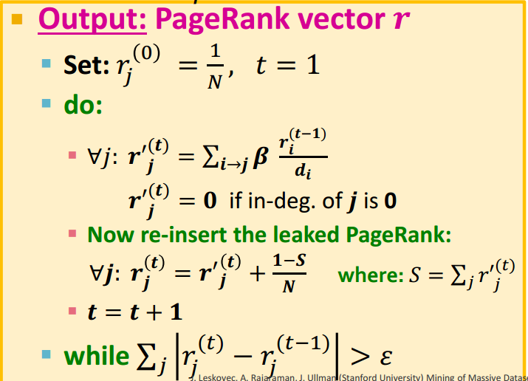
Complete algorithm

Slide 23
Implementation
CPU
  Graph representation: Adjecency list
  O(m) per iteration, where m is the number of edges
  m = O(n) => O(n) per iteration
CUDA
  Graph representation: Adjecency matrix
  O(n²) per iteration

Slide 24
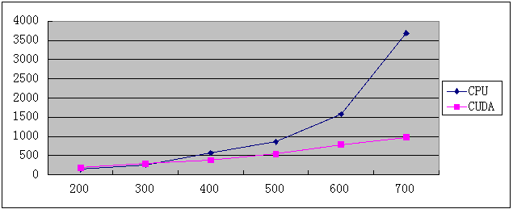
CUDA vs CPU
Number of pages | CPU | CUDA
300 | 290 ms | 340 ms
400 | 570 ms | 380 ms
500 | 860 ms | 550 ms
>850000 | ~6.5 s | Memory overflow

Slide 25
Questions?
Thanks for the attention!

